Slide 1

Trees (BST, ADT)
https://youtu.be/vVgbnpt3dnQ
https://youtu.be/Yl-Jvfr0zV4
https://youtu.be/f1xQwp-C_hQ
https://youtu.be/4sKNB4Oy3-A
ADT, Applications
Samin Ahmed
FAST-NUCES
Peshawar Campus

Slide 2

Introduction to Trees
A tree is a hierarchical data structure that consists of nodes connected by edges. It is a non-linear data structure used for efficient searching, sorting, and hierarchical representation.
Every tree is called a graph.
But every graph is not a Tree.
Why?
Graph contains cycles.
Trees do not contain cycles.

Slide 3
Key Terminologies
Node(Vertice): Each element in a tree.
Root: The topmost node of the tree.
Edge: A line (branch) connecting two nodes.
Parent & Child: The node that has branches leading to other nodes is a parent, and the connected nodes are children.
Siblings: Nodes with the same parent.
Leaf/External/Exterior Node: A node with no children.
Internal/Interior Node: A node that has children
Degree of a Node: The number of children a node has.
Depth of a Node: Distance from a node to root node.
Height of a Node: Distance from a node to leaf node.
Height of a Tree: The longest path from the root node to leaf.
Depth of a tree: The length of the longest path from the leaf node to root node.
Degree of a tree: The maximum number of children any node in the tree has.

Slide 4
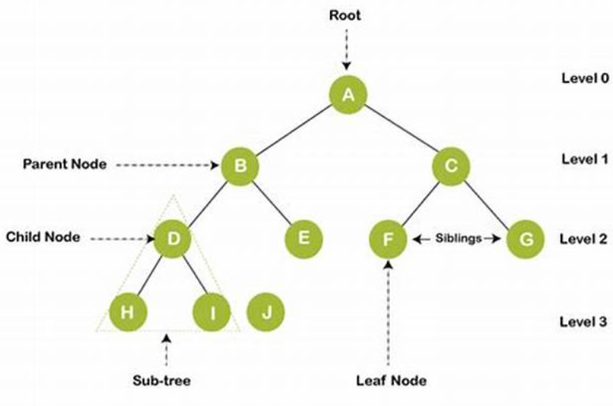
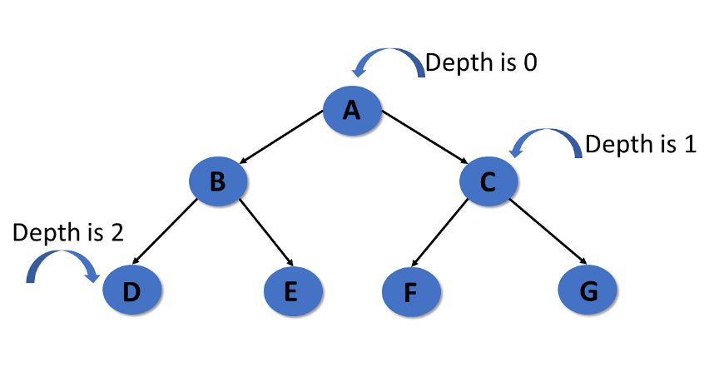
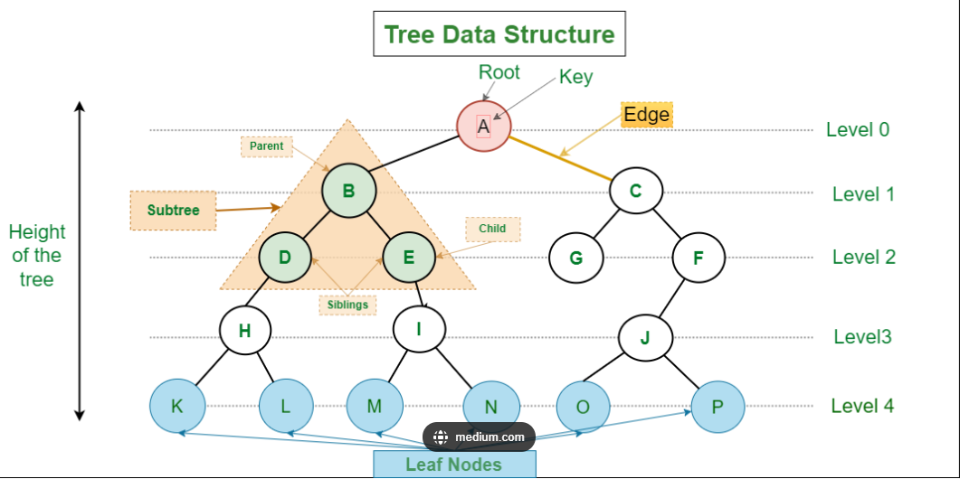
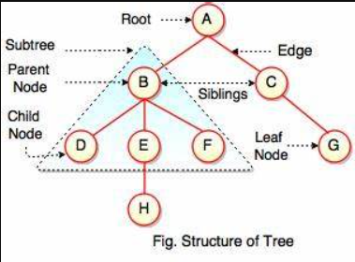
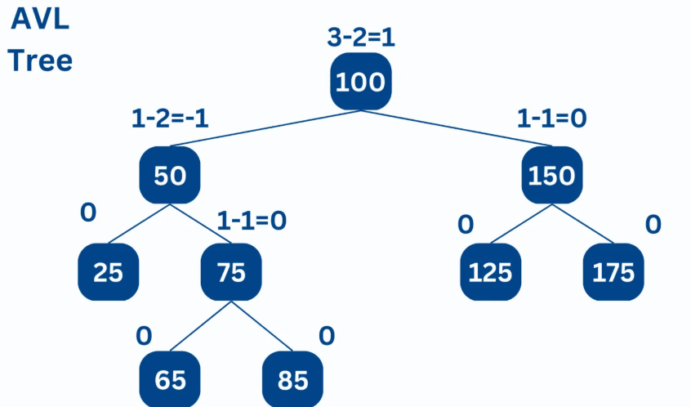
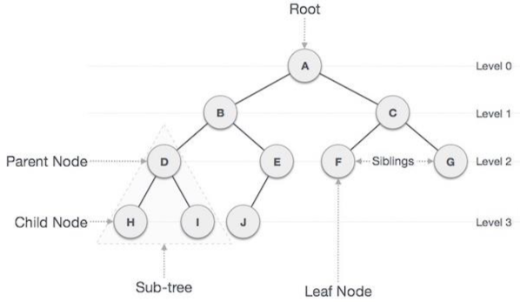
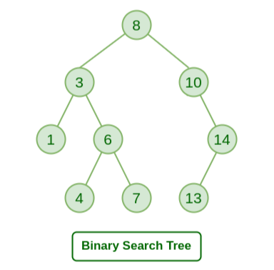
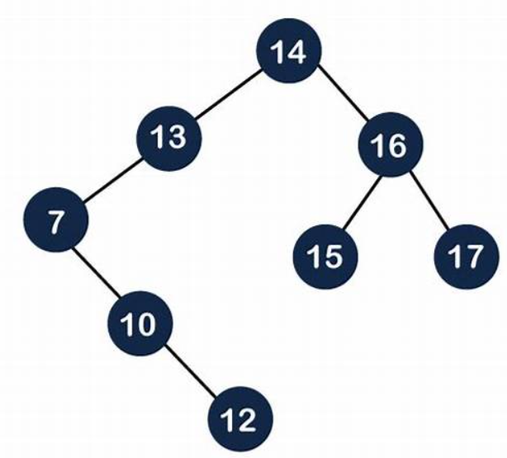
Tyes of Trees (Binary Tree)
General Tree: No restrictions on the number of children.
Binary Tree: Each node has at most two children.
Full Binary Tree/ Strictly Binary Tree : Every node has either 0 or 2 children.
Complete Binary Tree: All levels are fully filled except possibly the last, which is filled from left to right. (no gaps in between at the last level).
Perfect Binary Tree/ Strictly Complete Binary Tree : All internal nodes have two children, and all leaf nodes are at the same level.
Incomplete Binary Tree: A binary tree that does not satisfy the conditions of being full or complete; it has missing nodes in levels other than possibly the last, or not all internal nodes have two children.
Binary Search Tree (BST): A binary tree where the left child is smaller, and the right child is larger than the parent.
AVL Tree: A self-balancing BST

Slide 5
#include <iostream>
#include <iomanip>
#include <conio.h>
#include <queue>
using namespace std;
const int INSERT=1;const int DELETE=2;const int SEARCH=3;const int MINIMUM=4;const int MAXIMUM=5;
const int INORDER=6;const int PREORDER=7;const int POSTORDER=8;const int DISPLAY=9;const int TREE_HEIGHT=10;
const int COUNT_NODES=11; const int NODE_HEIGHT=12; const int NODE_DEPTH = 13; const int COUNT_NODES_AT_LEVEL = 14;
const int FIND_PARENT = 15; const int FIND_LEFT_CHILD = 16;const int FIND_RIGHT_CHILD = 17;
const int BREADTH_FIRST_SEARCH = 18;
const int EXIT=19;
class Node {
public:
int data;
Node* left;
Node* right;
Node(int value) : data(value), left(nullptr), right(nullptr) {}
};
BST(ADT) (constants & Node Class)

Slide 6
BST(ADT) (BST Class, private section)
class BST {
private:
Node* root;
Node* insert(Node* root, int value) {
if (root == nullptr) return new Node(value);
if (value < root->data) root->left = insert(root->left, value);
else root->right = insert(root->right, value);
return root;
}
Node* deleteNode(Node* root, int key) {
if (root == nullptr) return root;
if (key < root->data) root->left = deleteNode(root->left, key);
else if (key > root->data) root->right = deleteNode(root->right, key);
else {
if (root->left == nullptr) { Node* temp = root->right; delete root; return temp; }
else if (root->right == nullptr) { Node* temp = root->left; delete root; return temp; }
Node* temp = findMin(root->right);
root->data = temp->data;
root->right = deleteNode(root->right, temp->data);
}
return root;
}

Slide 7
BST(ADT) (BST Class, private section)
Node* findMin(Node* root) {
while (root && root->left != nullptr)
root = root->left; return root;
}
Node* findMax(Node* root) {
while (root && root->right != nullptr)
root = root->right; return root;
}
bool search(Node* root, int key) {
if (root == nullptr) return false;
if (key == root->data) return true;
if (key < root->data)
return search(root->left, key);
else
return search(root->right, key);
}
void display(Node* root, int space) {
const int INDENT = 6;
if (root == nullptr) return;
display(root->right, space + INDENT);
cout << setw(space) << ' ' << root->data << endl;
display(root->left, space + INDENT);
}
void inorder(Node* root) {
if (root != nullptr) {
inorder(root->left);
cout << root->data << " ";
inorder(root->right);
}
}
void preorder(Node* root) {
if (root != nullptr) {
cout << root->data << " ";
preorder(root->left);
preorder(root->right);
}
}
void postorder(Node* root) {
if (root != nullptr) {
postorder(root->left);
postorder(root->right);
cout << root->data << " ";
}
}

Slide 8
BST(ADT) (BST Class, private section)
int findHeight(Node *root) {
if (root == nullptr) return -1;
else {
int leftHeight = findHeight(root->left);
int rightHeight = findHeight(root->right);
return 1 + ((leftHeight > rightHeight) ? leftHeight : rightHeight);
}
}
int countNodes(Node* root) {
if (root == nullptr) return 0;
return 1 + countNodes(root->left) + countNodes(root->right);
}
Node* findNode(Node* root, int key) {
if (root == nullptr || root->data == key) return root;
if (key < root->data) return findNode(root->left, key);
else return findNode(root->right, key);
}
int NodeHeight(Node* node) {
if (node == nullptr) return -1;
int leftHeight = findHeight(node->left);
int rightHeight = findHeight(node->right);
return 1 + ((leftHeight > rightHeight) ? leftHeight : rightHeight);
}
int NodeDepth(Node* root, int key, int depth = 0) {
if (root == nullptr) return -1;
if (root->data == key) return depth;
if (key < root->data)
return NodeDepth(root->left, key, depth + 1);
else
return NodeDepth(root->right, key, depth + 1);
}
int countNodesAtLevel(Node* node, int level) {
if (node == nullptr) return 0;
if (level == 0) return 1;
return countNodesAtLevel(node->left, level - 1) +
countNodesAtLevel(node->right, level - 1);
}
Node* findParent(Node* node, int value) {
if (node == nullptr || node->data == value)
return nullptr;
if ((node->left && node->left->data == value) ||
(node->right && node->right->data == value))
return node;
if (value < node->data)
return findParent(node->left, value);
else
return findParent(node->right, value);
}

Slide 9
BST(ADT) (BST Class, private section)
void destroyTree(Node* root) {
if (root != nullptr) {
destroyTree(root->left);
destroyTree(root->right);
delete root;
}
}
int NodeDepth(Node* root, int key, int depth = 0) {
if (root == nullptr) return -1;
if (root->data == key) return depth;
if (key < root->data) return NodeDepth(root->left, key, depth + 1);
else return NodeDepth(root->right, key, depth + 1);
}
int countNodesAtLevel(Node* node, int level) {
if (node == nullptr) return 0;
if (level == 0) return 1;
return countNodesAtLevel(node->left, level - 1) + countNodesAtLevel(node->right, level - 1);
}
Node* findParent(Node* node, int value) {
if (node == nullptr || node->data == value) return nullptr;
if ((node->left && node->left->data == value) || (node->right && node->right->data == value))
return node;
if (value < node->data)
return findParent(node->left, value);
else
return findParent(node->right, value);
}

Slide 10
BST(ADT) (BST Class, public section)
public:
BST() : root(nullptr) {}
~BST() {
destroyTree(root);
}
void insert(int value) {
root = insert(root, value);
}
void deleteValue(int key) {
root = deleteNode(root, key);
}
bool search(int key) {
return search(root, key);
}
int findMin() {
Node* temp = findMin(root);
return temp ? temp->data : -1;
}
int findMax() {
Node* temp = findMax(root);
return temp ? temp->data : -1;
}
void inorderTraversal() {
cout << "Inorder: ";
inorder(root);
cout << endl;
}
void preorderTraversal() {
cout << "Preorder: ";
preorder(root);
cout << endl;
}
void postorderTraversal() {
cout << "Postorder: ";
postorder(root);
cout << endl;
}
void display() {
cout << "\nTree structure (root at left, right at top):\n";
display(root, 0);
}
int findHeight() {
return findHeight(root);
}

Slide 11
BST(ADT) (BST Class, public section)
int countNodes() {
return countNodes(root);
}
int NodeHeight(int value) {
Node* node = findNode(root, value);
if (!node) {
cout << "Node not found in tree.\n"; return -1;
}
return NodeHeight(node);
}
int NodeDepth(int key) {
return NodeDepth(root, key);
}
int countNodesAtLevel(int level) {
return countNodesAtLevel(root, level);
}
Node* findParent(int value) {
return findParent(root, value);
}
int getLeftChild(int value) {
Node* node = findNode(root, value);
if (node && node->left)
return node->left->data;
else {
cout << "Left child not found for node " << value << ".\n"; return -1;
}
}
int getRightChild(int value) {
Node* node = findNode(root, value);
if (node && node->right) return node->right->data;
else {
cout << "Right child not found for node " << value << ".\n"; return -1;
}
}

Slide 12
BST(ADT) (BST Class, public section)
void breadthFirstTraversal() {
if (root == nullptr) { cout << "Tree is empty.\n"; return; }
queue<Node*> q; q.push(root); cout << "BFS (Level Order): ";
while (!q.empty()) {
Node* current = q.front(); q.pop();
cout << current->data << " ";
if (current->left) q.push(current->left);
if (current->right) q.push(current->right);
}
cout << endl;
}
};

Slide 13
BST(ADT) (main function)
int main() {
BST tree;
int choice, value, left_child, right_child;
do {
cout << "\n====== BST Operations Menu ======" << endl
<< "1. Insert\n" << "2. Delete\n" << "3. Search\n"
<< "4. Find Minimum\n" << "5. Find Maximum\n"
<< "6. Inorder Traversal\n" << "7. Preorder Traversal\n"
<< "8. Postorder Traversal\n" << "9. Display Tree Structure\n"
<< "10. Height Of Tree Structure\n"
<< "11. Count Nodes in Tree Structure\n"
<< "12. Find Height of a Node\n"
<< "13. Find Depth of a Node\n"
<< "14. Count Nodes at a Given Level\n"
<< "15. Find Parent of a Node\n"
<< "16. Find Left Child of a Node\n"
<< "17. Find Right Child of a Node\n"
<< "18. Breadth First Search (Traversal) \n"
<< "19. Exit\n"
<< "Enter your choice: ";
cin >> choice;

Slide 14
BST(ADT) (main function)
switch (choice) {
case INSERT: cout << "Enter value to insert: "; cin >> value; tree.insert(value);
break;
case DELETE: cout << "Enter value to delete: "; cin >> value; tree.deleteValue(value);
break;
case SEARCH: cout << "Enter value to search: "; cin >> value; if (tree.search(value)) cout << "Value found in tree.\n";
else cout << "Value not found.\n";
break;
case MINIMUM: value = tree.findMin(); if (value != -1) cout << "Minimum value: " << value << endl;
else cout << "Tree is empty.\n";
break;
case MAXIMUM: value = tree.findMax(); if (value != -1) cout << "Maximum value: " << value << endl;
else cout << "Tree is empty.\n";
break;
case INORDER: tree.inorderTraversal();
break;
case PREORDER: tree.preorderTraversal();
break;
case POSTORDER: tree.postorderTraversal();
break;
case DISPLAY: tree.display();
break;
case TREE_HEIGHT: cout<<"\n height of the tree is: "<<tree.findHeight();
break;

Slide 15
BST(ADT) (main function)
case EXIT: cout << "Exiting program. Thank you!\n";
break;
case COUNT_NODES: cout<<"\ntotal number of nodes in the tree = "<<tree.countNodes();
break;
case NODE_HEIGHT: cout << "Enter node value to find its height: "; cin >> value;
cout << "Height of node " << value << " is: " << tree.NodeHeight(value) << endl;
break;
case NODE_DEPTH:
cout << "Enter node value to find depth: "; cin >> value;
{
int depth = tree.NodeDepth(value);
if (depth != -1)
cout << "Depth of node " << value << ": " << depth << endl;
else
cout << "Node not found.\n";
}
break;
case COUNT_NODES_AT_LEVEL:
cout << "Enter level to count nodes at: "; cin >> value;
cout << "Number of nodes at level " << value << ": "
<< tree.countNodesAtLevel(value) << endl;
break;

Slide 16
BST(ADT) (main function)
case FIND_PARENT:
cout << "Enter value to find its parent: "; cin >> value;
{
Node* parent = tree.findParent(value);
if (parent)
cout << "Parent of " << value << " is: " << parent->data << endl;
else
cout << "No parent found (node may be root or not exist).\n";
}
break;
case FIND_LEFT_CHILD:
cout << "Enter node value to find its left child: "; cin >> value;
left_child = tree.getLeftChild(value);
if (left_child != -1 ) cout<<"\n left child = "<<left_child;
break;
case FIND_RIGHT_CHILD:
cout << "Enter node value to find its right child: "; cin >> value;
right_child = tree.getRightChild(value);
if (right_child != -1 ) cout<<"\n right child = "<<right_child;
break;
case BREADTH_FIRST_SEARCH:
tree.breadthFirstTraversal();
break;
default:
cout << "Invalid choice. Try again.\n";
}
if (choice != EXIT){
cout<<"\n press any key to continue";
_ getch();
system("cls");
}
} while (choice != EXIT);
return 0;
}

